Slide 1


Fast Friends: Understanding the Impact of Short-term Migration on Firms’ Invention Outcomes
Hyo Kang
USC Marshall
John Eklund
USC Marshall
November 25, 2022
KAIST
Notes:
Early stage project – actively collecting feedback and suggestions!

Slide 2
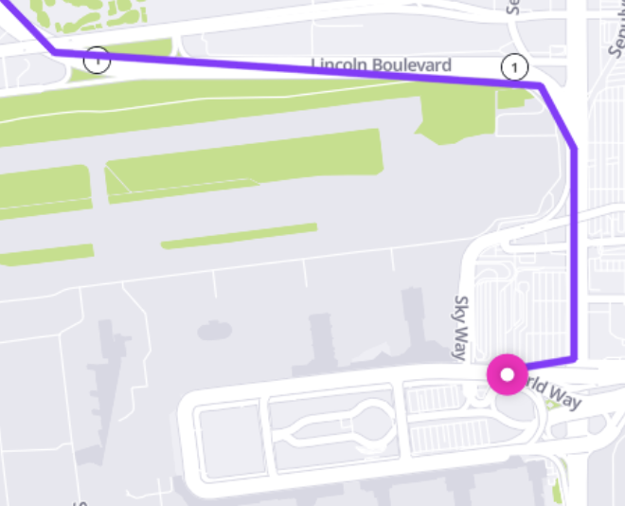
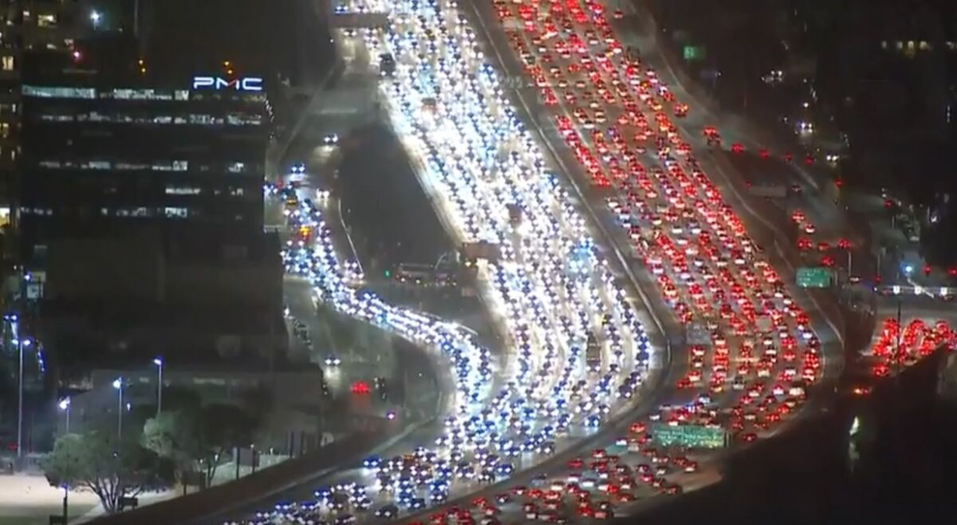
This Week
11/22 (Tue): Teaching (1-4pm), LAX (10pm), Flight (10:40pm)
11/23 (Wed): Disappeared
11/25 (Fri): KAIST visitation
11/28 (Mon): Teaching (8am-12pm)
Int’l terminal

Slide 3
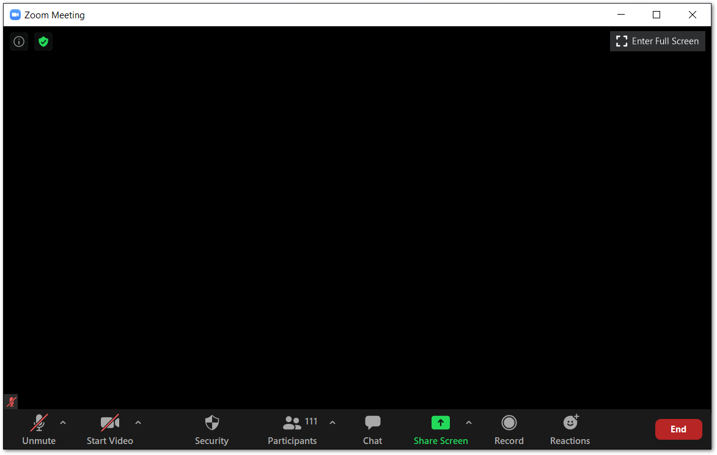
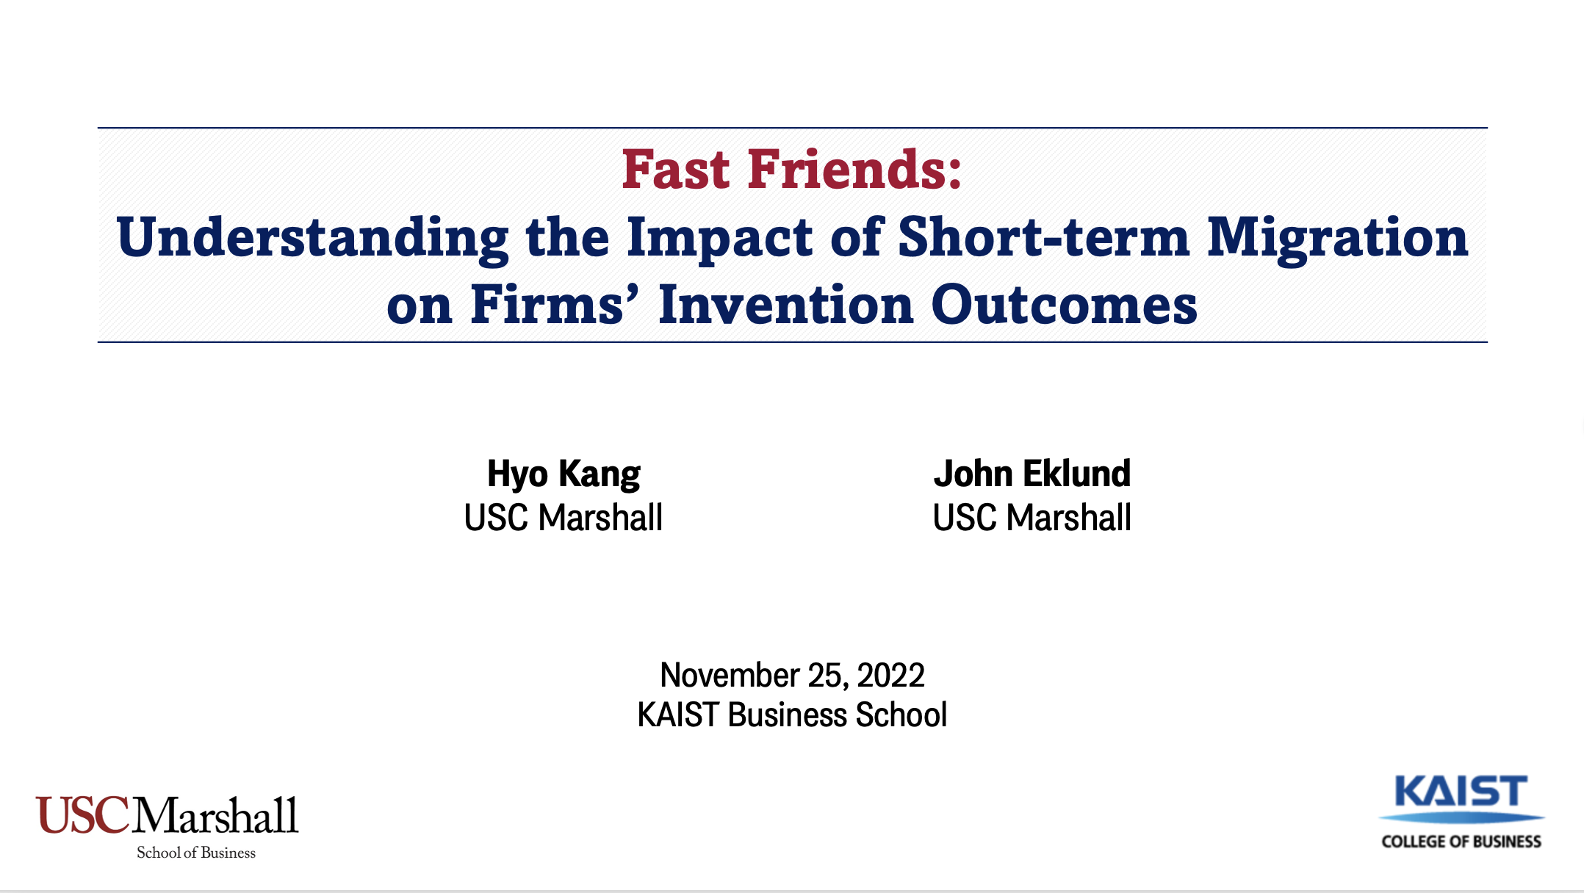

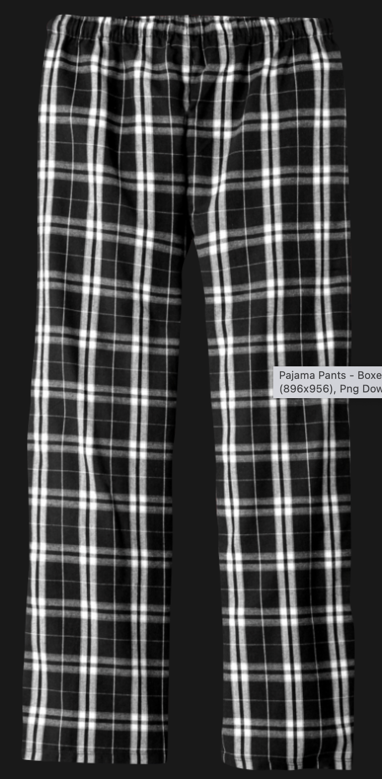
Notes:
Counterfactual – having a Zoom seminar [Figure needs to be updated]

Slide 4
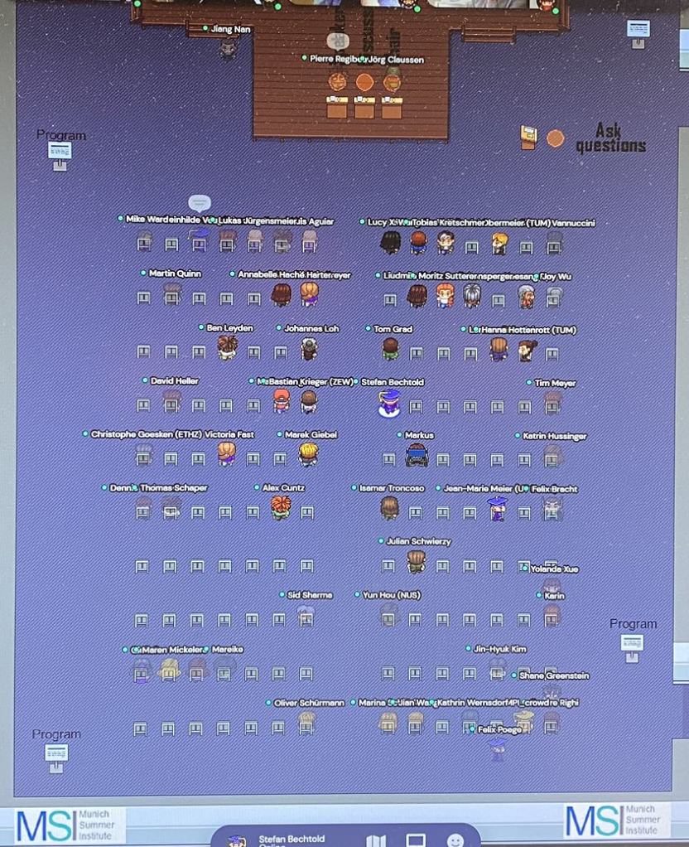
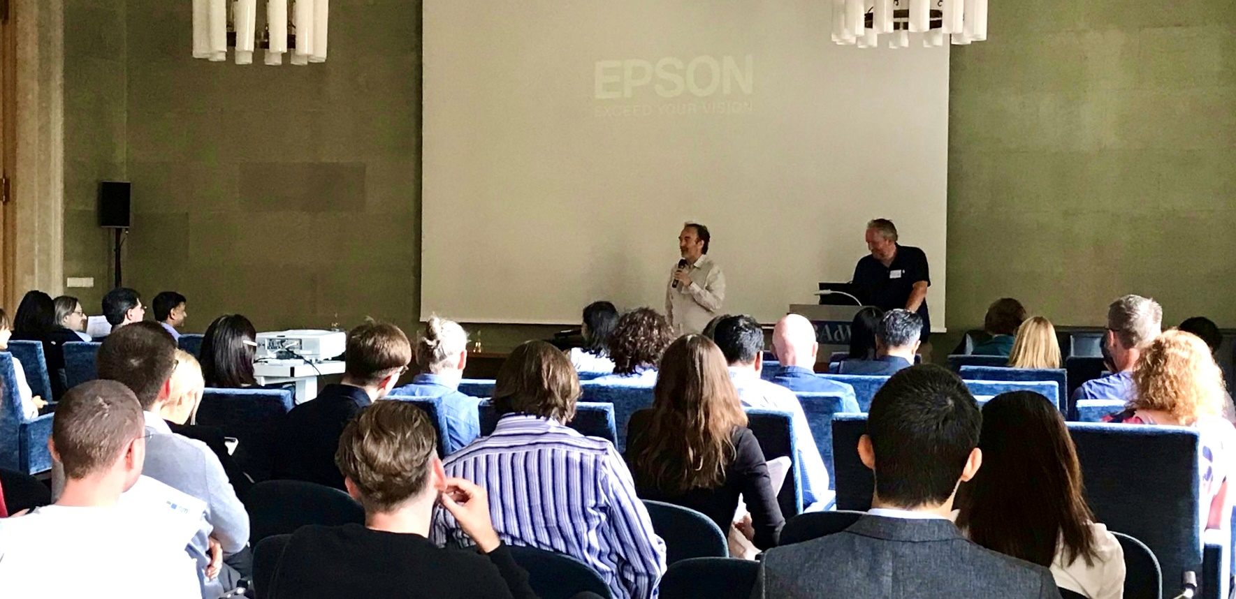
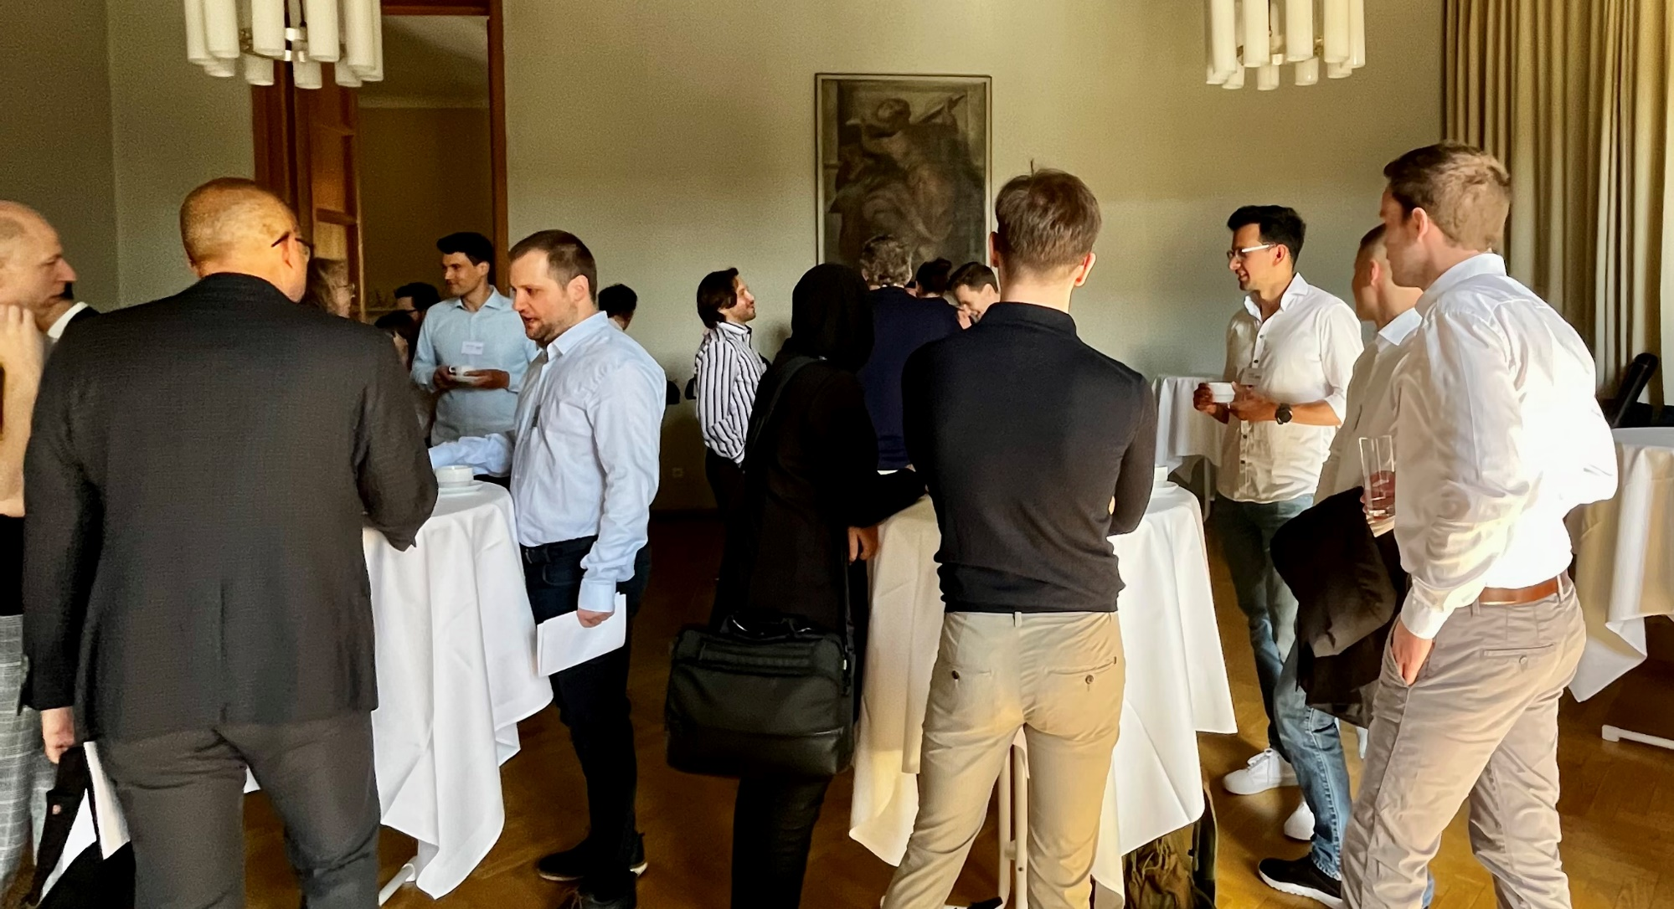
Munich Summer Institute 2021
Munich Summer Institute 2022
Notes:
2021: Online, Gather Town
2022: In person in Munich

Slide 5
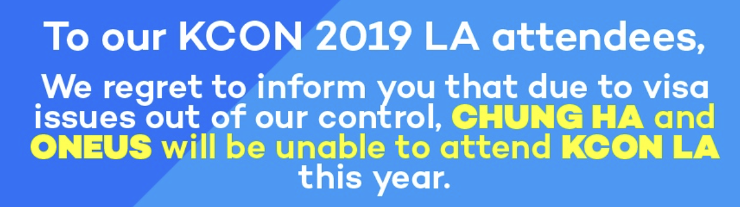
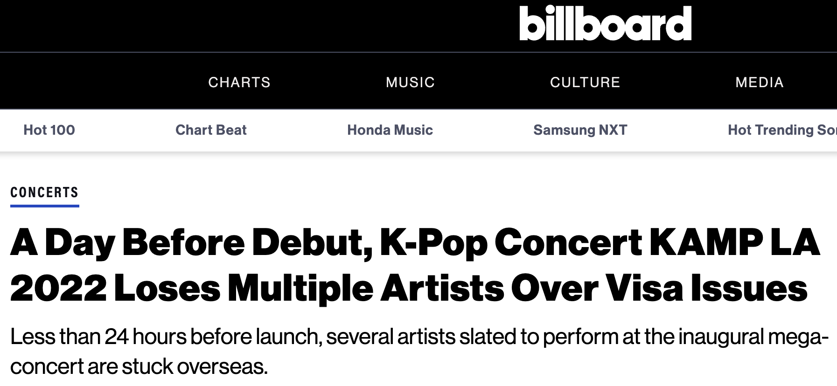

Although not a visitor visa,

Slide 6
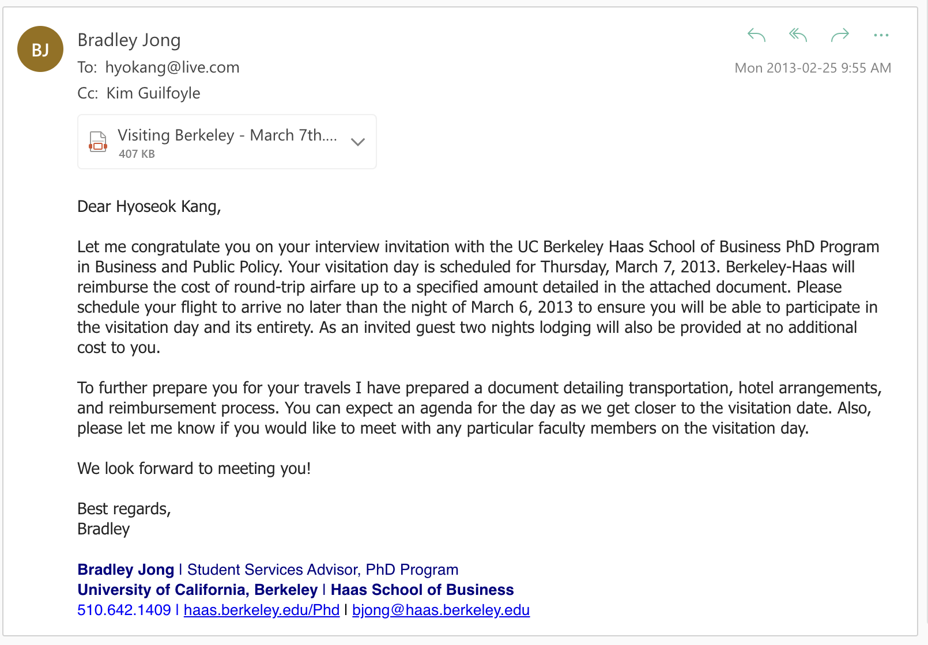
In 2013, I was invited to an on-campus interview
1/30: (1st) Skype interview
2/??: On-campus interview invitation
3/7: (2nd) On-campus interview

Slide 7
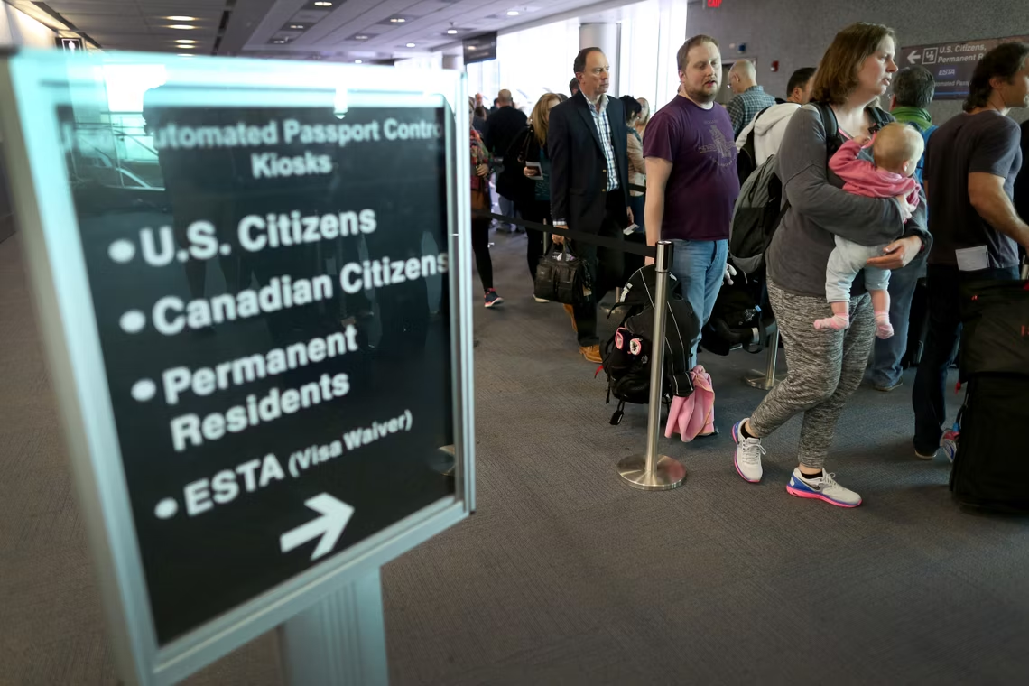
In 2013, I was invited to an on-campus interview
“Visa Waiver Program” (South Korea: 2008-)
Visited five schools
Helped me make the right decision

Slide 8


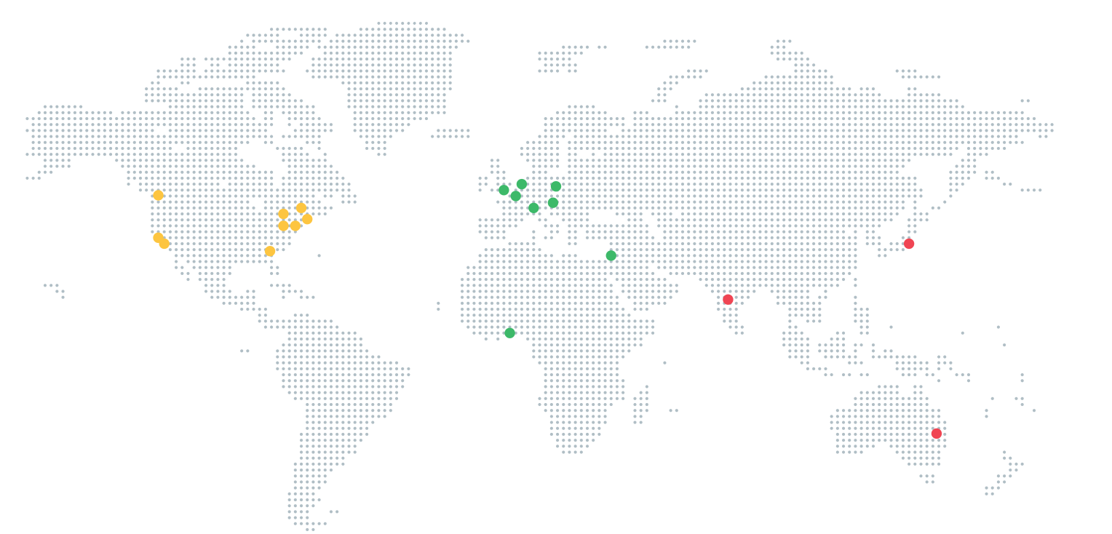
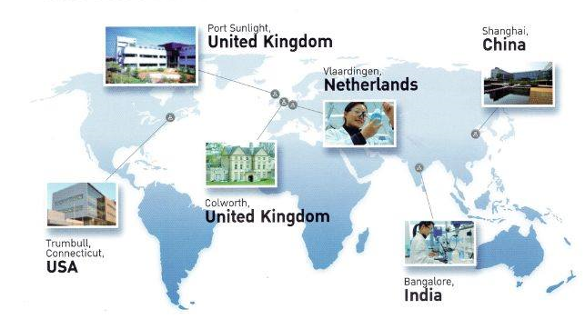
R&D is a global undertaking
> 25,000 R&D Employees
> 5,000 R&D Employees
Notes:
We tend to get obsessed about cool R&D being done in Silicon Valley and Boston, but R&D for many firms is a global effort drawing on the expertise of networks of laboratories across multiple countries so firms have access to a global talent pool
Here we see Alphabet that has a significant R&D presence in Europe and Asia. Such as Deep Mind AI research in London, Alphabet X in India working on remote wifi access and a product development center in Nairobi and operations in Lagos Nigeria
Unilever R&D a former employer of mine has a network of labs in multiple countries and I have had the pleasure of visiting both labs in the UK, lab in the USA and China. They used to have a lab in Edgewater New Jorsey I believe it is pronounced that I came to on many occasions from my base in Port Sunlight to learn how to apply shower gel technology to shampoos, you may snigger shower gel technology there is a lot of patenting in this area and in Shampoos!

Slide 9
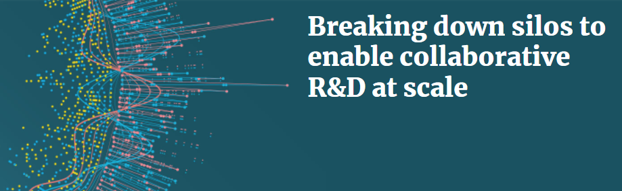
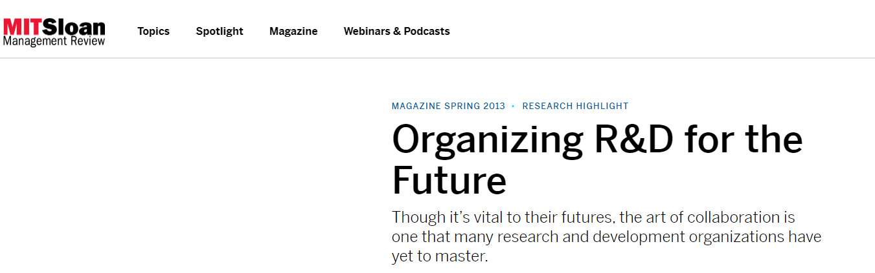
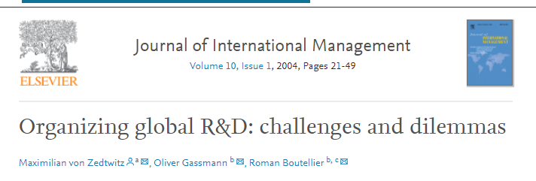
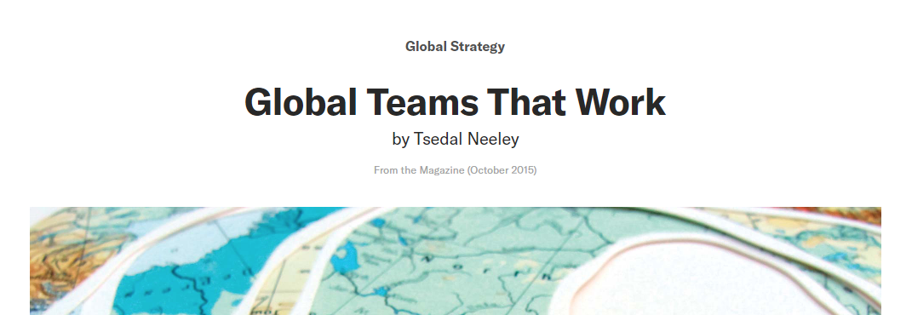
R&D is a global undertaking
However, firms may struggle to ensure the whole is greater than the sum of the parts
Notes:
The problem that firms face is that firms cannot make the whole greater than the sum of the parts as illustrated by these articles in academic and practitioner journals.
It is challenging for the large firms to get these disparate labs working together to recombine their knowledge to create new inventions. With challenges such as siloed thinking, difficulties in communication and conflicting objectives these networks may not be as effective as they could be.

Slide 10
Ultimately firms face two challenges for invention efforts
A
B
C
Creates coordination challenges
Division of tasks
Allocation of tasks
Feedback and adaptation
D
E
F
Division of Labor
A
B
C
Creates cooperation challenges
Knowledge sharing
Trust in each others’ actions
D
E
F
Integration of Effort
Source: Puranam, Alexy & Reitzig (2014)
Notes:
Ultimately we argue that firms face an organization design problem when managing large global R&D footprints
From the work of Phanish Puranam we know that org design consists of solving problems associated with the divison of labor and the integration of the effort of that divided labor
This sets up both coordination and cooperation challenges

Slide 11
A key challenge is ensuring effective knowledge flows
The Global R&D Processes
Innovation involves the recombination of diverse knowledge (DeSanctis et al. 2002; Fleming 2001)
Firms must have effective intra-organizational knowledge flows (Grant 1996; Eklund 2022)
Challenges
Such knowledge flows can become constricted across different global R&D laboratories (Allen 1984; Gupta & Govindarajan 2000)
Laboratories often work in isolation not taking advantage of the knowledge in other laboratories

Slide 12
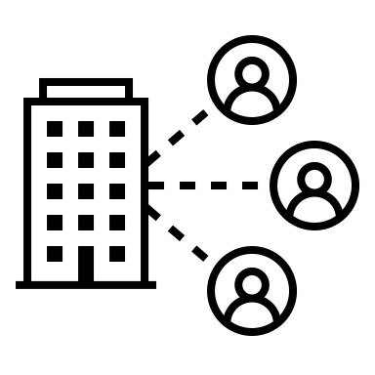

Short-term visits help!
Short-term visits
(<90 days)
Lab A in
Country X
Lab B in
Country Y

Slide 13
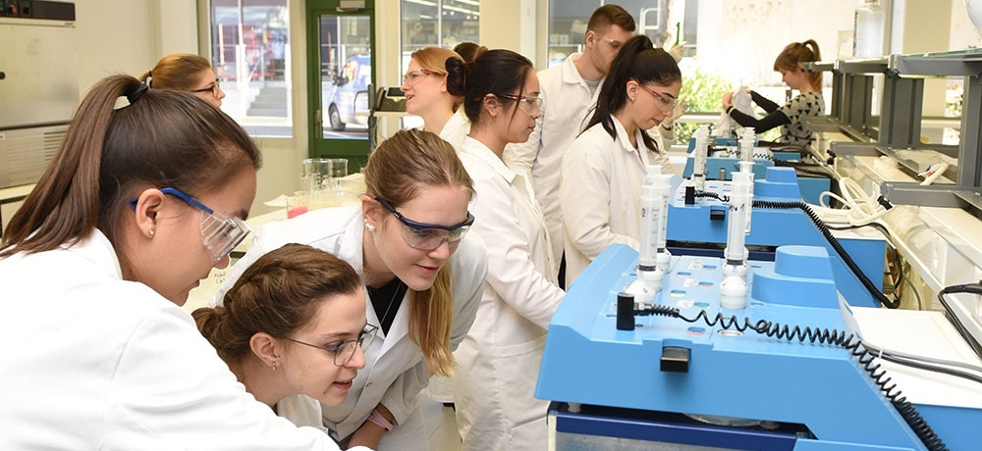

Research Question
How do short-term visits of a firm’s employees between their international R&D centers impact its invention outcomes?
Notes:
Our research question is focused on when short term migration can help firm’s global R&D efforts.

Slide 14
Theoretical background
Short-term migration provides a richer face-to-face communication medium for a firm’s scientists to interact
Enhances the R&D organization through (Puranam et al. 2014, Puranam 2018)
Coordination between scientists
Cooperation between scientists
Notes:
So we argue that ST migration provides a richer communication medium for scientists to interact than phone or email used at distance
This facilitates firms R&D efforts through enhancing effectiveness of org design through enhancing intraorganizational coordination and cooperation
Discuss quotes

Slide 15
Theoretical background: Coordination
Short-term visits facilitate coordination through timely feedback and richer communication medium (Allen, 1984)
More effective feedback ensures:
Costly errors are avoided (Lawrence and Lorsch 1967)
Wider array of ideas can be evaluated (Fleming 2001; Levinthal 1997)
More efficient execution of invention tasks
Ensures that more possible knowledge combinations are evaluated in a certain period of time
“I could see the process in real-time and it enabled me to ask more insightful questions. Without the visit, I would have been stuck asking very basic questions that could be easily answered by observation.”
“The visitor can bring a broader group of scientists into the discussion as opposed to just the people in the call which can help in uncovering the more specific details of science which can help the science to be shared more effectively”
Notes:
So we argue that ST migration provides a richer communication medium for scientists to interact than phone or email used at distance
This facilitates firms R&D efforts through enhancing effectiveness of org design through enhancing intraorganizational coordination and cooperation
Discuss quotes

Slide 16
Theoretical background: Cooperation
Short-term visits facilitate cooperation through building trust and richer relationships (Hinds & Bailey, 2003)
Engendering greater trust ensures:
Knowledge is shared readily (Szulanski 1996)
Others’ knowledge is trusted and leveraged effectively (Brattström et al. 2012)
More effective execution of invention tasks
Ensures that more possible knowledge combinations are evaluated in a certain period of time
“The trip enabled me to uncover a group of different people with highly relevant skills that I was able to build a personal relationship with so that they would respond to my calls and emails”
Notes:
So we argue that ST migration provides a richer communication medium for scientists to interact than phone or email used at distance
This facilitates firms R&D efforts through enhancing effectiveness of org design through enhancing intraorganizational coordination and cooperation
Discuss quotes
So how do enhanced coordination and cooperation associated with ST invention facilitate firms’ invention efforts
We argue that coordination is enhanced due to more effective feedback which enables costly errors to be avoided and firms invention to be more efficient as evaluate more options of knowledge recombination in a certain period of time
Whereas cooperation arises from increased trust following ST visits which results in knowledge being readily shared and allowing more combinations to be developed and evaluated

Slide 17
Theoretical Framework
An easing of visa restrictions for short-term travel between a firm’s R&D centers located in different countries will be associated with an increase in that firm’s invention productivity (H1) and scope (H2).
Notes:
This sets up a theoretical framework in which
ST visit leads to better feedback as a richer comms medium which in turn facilitates better intraorganizational coordination and better invention outcomes
Also ST engender more trust between scientists and enhanced cooperation and also better invention outcomes
We now look at conditions under which the benefits of coordination and cooperation resulting from ST visits are magnified further enhancing firms’ invention outcomes

Slide 18

Theoretical background
We then investigate conditions under which short-term migration will have the strongest positive impact on firm’s invention outcomes

Slide 19
Knowledge Overlap
Greatest benefits at intermediate overlap
Marginal coordination benefits of short-term visits
With no common knowledge, short-term visit insufficient to obtain coordination benefits
Marginal coordination benefits limited as other media can help coordination
Knowledge overlap between R&D centers
Notes:
First we look at conditions under which the benefits of coordination associated with ST visits will be magnified
We look at knowledge overlap: low no real coordination benefit of ST visit as common understanding of problem and coordination challenges low, then benefits increase as degree of overlap declines but if too great coordination challenge may be too great too overcome from a short term visit and limited coordination benefits from ST visits need lt visits
So H3 is and here is a quote to illustrate this importance of just the right level of knowledge overlap

Slide 20
H3: Knowledge Overlap
It is important that these short-term visitors come with a slightly different skill set to what my research group has, so that we can learn from them, and they can learn from us
I’ve tried collaborating with scientists in very different domains to mine but these efforts have not really been that productive and not got off the ground.
The positive association between an easing of visa restrictions for short-term travel between a firm’s R&D centers located in different countries and a firm’s invention productivity/scope is more positive when the R&D centers have an intermediate degree of overlapping knowledge

Slide 21
H4: Spoken Language
… a non-native English speaker … often had to resort to writing things down for them to communicate
Lack of common language
Knowledge dismissed (Choudhury and Kim, 2019)
Greater chance of misunderstanding (Szulanski, Ringov, & Jensen, 2016)
Reduced trust as lose nuance in comms. (Oldroyd, Morris, & Dotson, 2019)
… short-term visits help for both scientific parties to develop respect for each other
The positive association between an easing of visa restrictions for short-term travel between a firm’s R&D centers located in different countries and a firm’s invention productivity/scope is more positive when the R&D centers have different primary spoken languages
Notes:
For H4 we look when at when the cooperation benefits of ST visits are likely to be magnified
When firms do not share common language, there is likely to be reduced trust and cooperation for three reasons, knowledge dismissed, misunderstandings and reduced trust as lose nuance in contrast if share language baseline trust and cooperation likely to be higher
Thus ST benefits will have bigger marginal impact if two labs have different spoken languages on increase in level of tructs and subsequent cooperation.
Hence H4 is and some quotes to support this

Slide 22
Theoretical framework

Slide 23
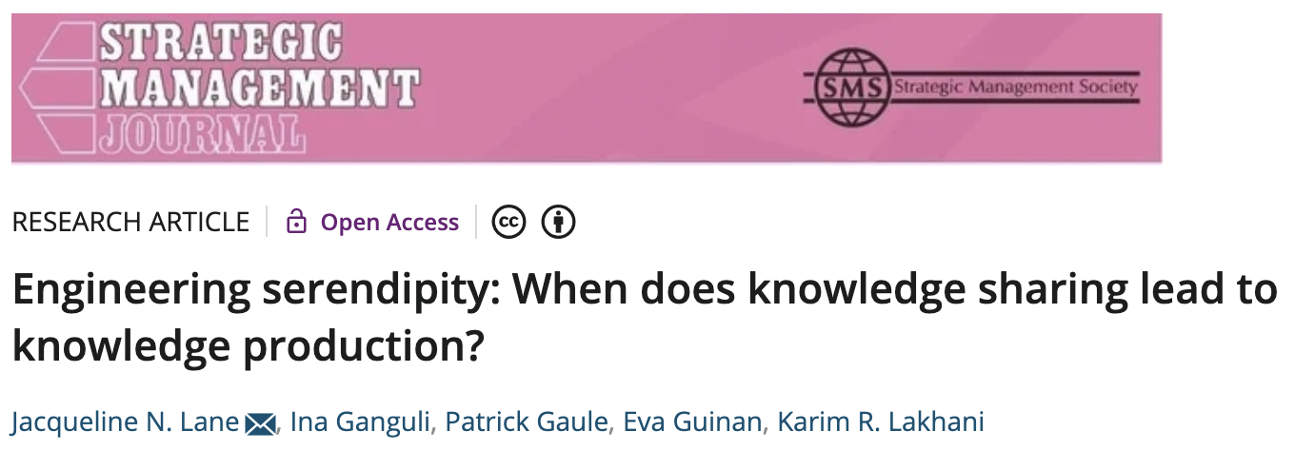
Theoretical background
Research Summary
We investigate how knowledge similarity between two individuals is systematically related to the likelihood that a serendipitous encounter results in knowledge production. We conduct a field experiment at a medical research symposium, where we exogenously varied opportunities for face-to-face encounters among 15,817 scientist-pairs. Our data include direct observations of interaction patterns collected using sociometric badges, and detailed, longitudinal data of the scientists' postsymposium publication records over 6 years. We find that interacting scientists acquire more knowledge and coauthor 1.2 more papers when they share some overlapping interests, but cite each other's work between three and seven times less when they are from the same field. Our findings reveal both collaborative and competitive effects of knowledge similarity on knowledge production outcomes.

Slide 24
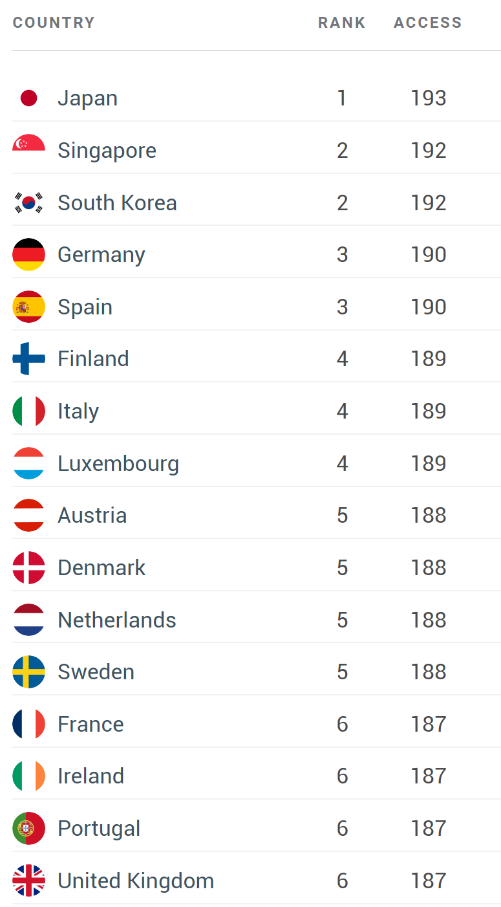
Empirical setting: Visas
“the number of destinations their holders can access without a prior visa”
Global Passport Power Ranking
Henley & Partners

Slide 25
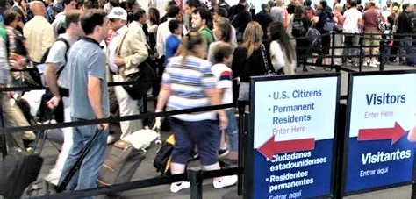
Empirical setting: U.S. Visas for Short-term Visits
United States visas
B-1 (Business) and B-2 (Tourism) Visas
Allows temporary visits to the U.S. (<180 days)
Immigrant visas
Nonimmigrant visas
IR1, CR1, K-3, K-1, IR3, IH3, IR4, IH4, IR2, CR2, IR5, F1, F3, F4, F2A, F2B, E1, E2, E3, EW3, C5, T5, R5, I5, S, SD, SR, SI, SQ, DV, SB
B-1, B-2, J, E-3, BCC, CW-1, D, A, G1-G5, NATO, J, A-2, NATO1-6, O, H-1B, H-1B1, Q, L, B-2, I, TN/TD, P, J, R, F, M, H-2A, H-2B, B-2, H-3, E, C, U, T, V

Slide 26
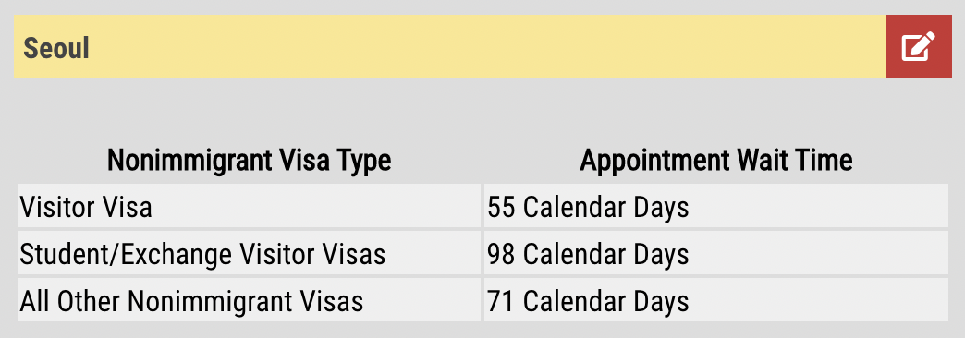

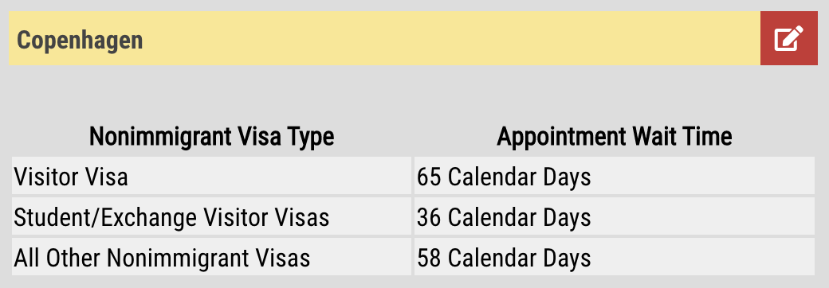
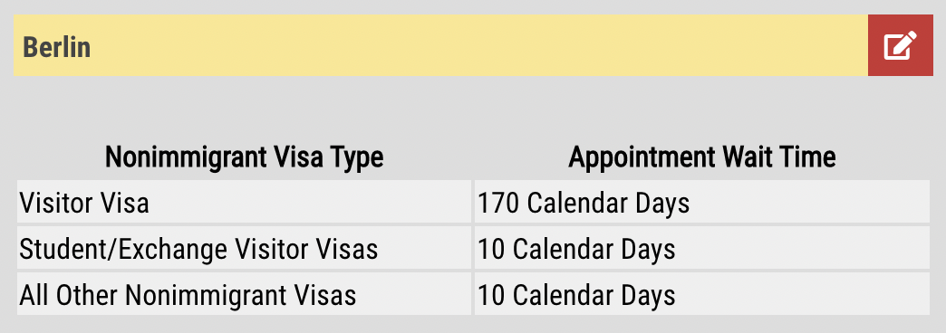
Getting a Visitor Visa is Difficult and Costly
“Applicants for visitor visas should generally apply at the nearest U.S. Embassy or Consulate in the country where they live. It is important to apply for a visa well in advance of the travel departure date”
Wait time as of 6/5/2022
Notes:
This was the case that it could take some time to apply for these visas as illustrated here
This could be a real barrier to visiting labs in the USA

Slide 27
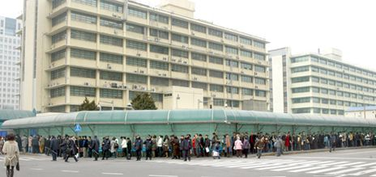
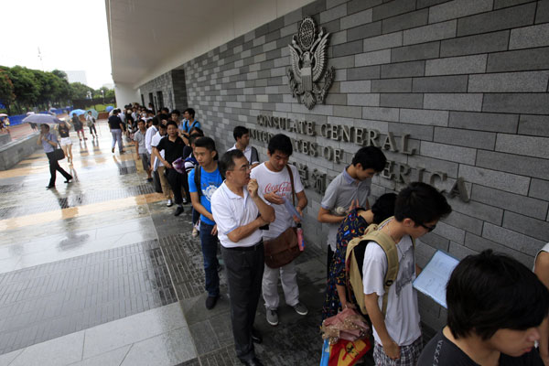
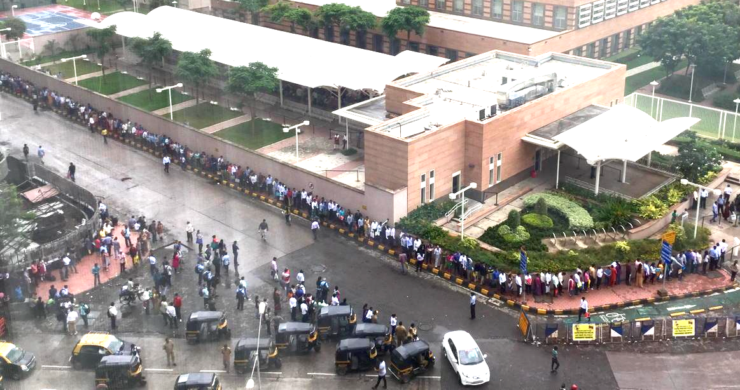
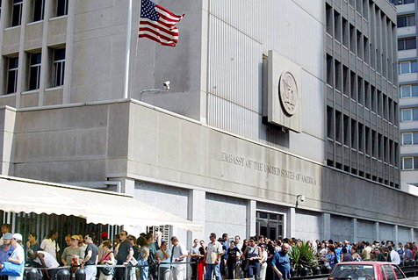
Getting a Visitor Visa is Difficult and Costly
US Embassy in Seoul, Korea
US Embassy in Guangzhou, China
US Consulate General in Mumbai, India
US Embassy in Tel Aviv, Israel
Notes:
To visually illustrate challenge of getting a visa to the USA look at these lines from US embassies around the world in Korea, Inida, China and Israel

Slide 28
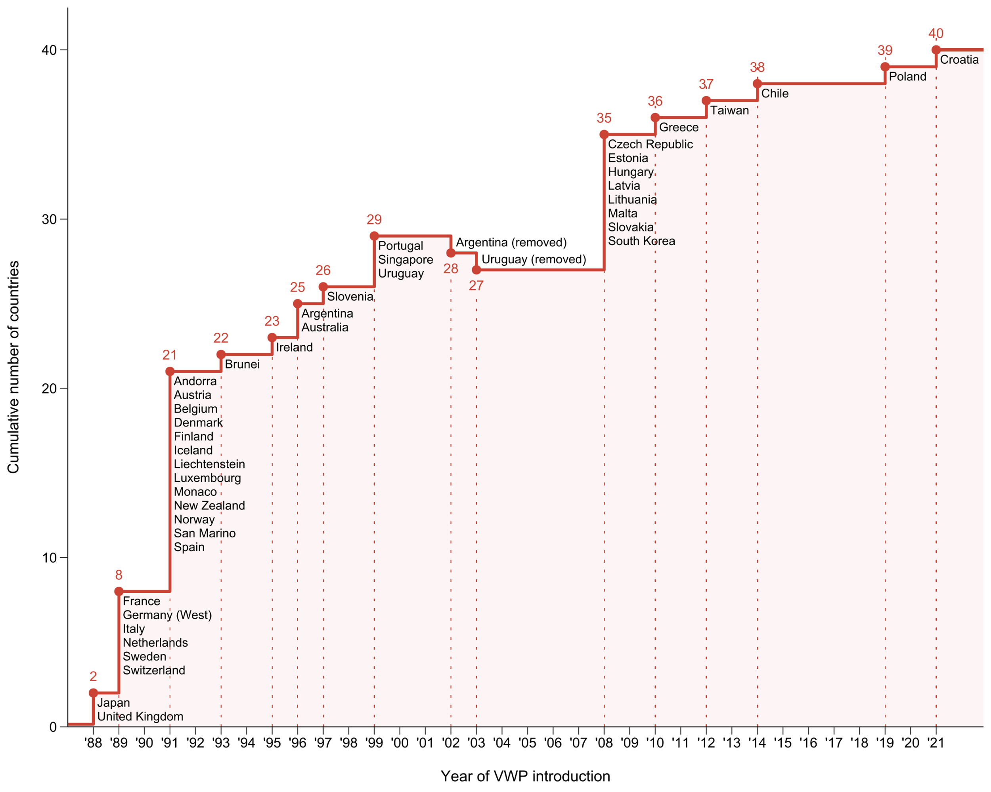
Empirical setting: U.S. Visa Waiver Program (VWP)
Staggered introduction across 42 countries (1988-2021)
Based on prior visa refusal rates for individuals from the relevant country
Notes:
However, starting in 1988 the USA introduced the short term visa waiver program where individuals could visit the USA visa free or apply for short term travel access simply online
The program was initially focused on the UK and Japan, but gradually expanded to other European countries and Asian and South American countries
This helped make it drastically easier to visit the USA for short periods

Slide 29
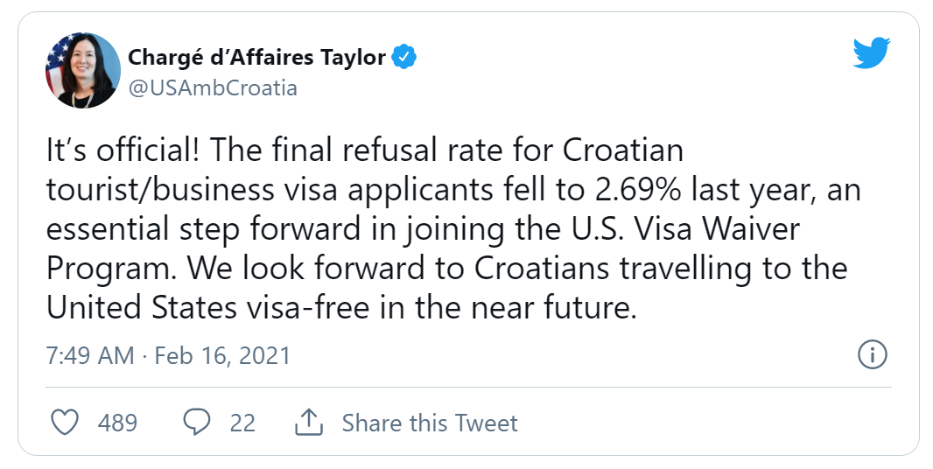
Empirical setting: U.S. Visa Waiver Program (VWP)
When Croatia joined the VWP in 2021…
Notes:
Charge d’Affaires: a diplomatic official who temporarily takes the place of an ambassador

Slide 30
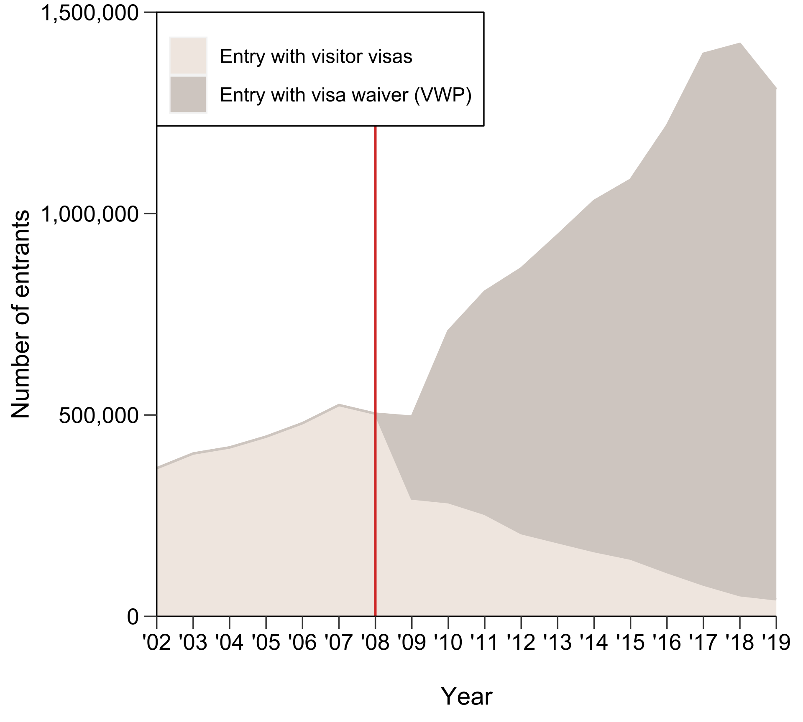
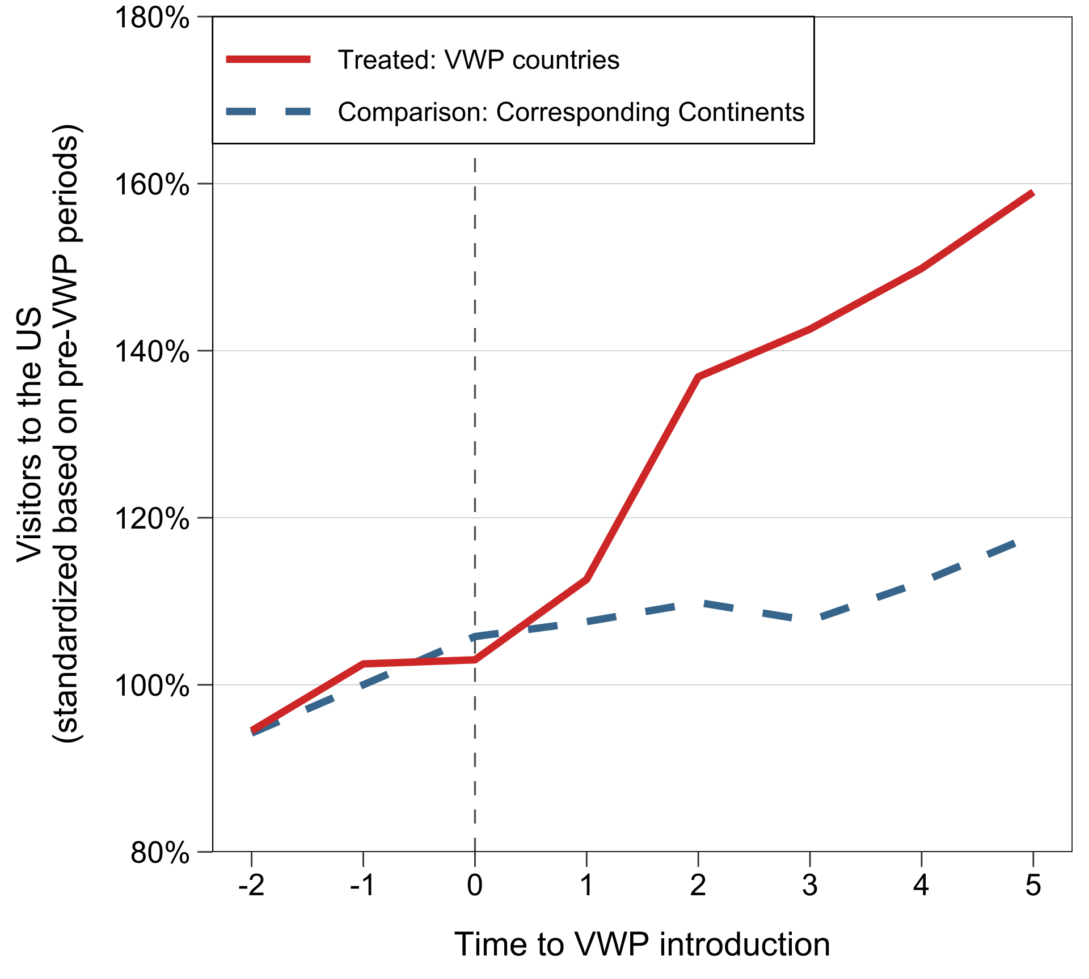
Empirical setting: U.S. Visa Waiver Program (VWP)
Visa Waiver Program permits travel to the U.S. without a visa
Significantly simplifies the process for entering the USA (up to 90 days)
South Korea (VWP: 2008)
All VWP Countries (2000-)
Notes:
Evidence that ST VWP program enhances migration to the USA for both SK and Taiwan

Slide 31
Data and variables
Global pharmaceutical industry (known to have a global R&D footprint)
Data | Source | Description
Sample company selection | Compustat | Focus on all firms SIC codes 2833-36
Invention Variables | PatentsView | Focus on US patents 1976-2020 Invention productivity: Number of patents per firm-year Invention scope: Average number of patent technology classes Knowledge overlap: The proportion of patent stocks in the overlapping technology fields (o) between the US and the treated non-US units over all patents Spoken Language: Indicator =1 if non-US lab primary language is English
Short-term visa waiver Introduction | US Dept of Homeland Security | Indicator set to 1 if country of firm’s overseas lab enters the visa waiver program else = 0
Notes:
We specifically look at the global pharmaceutical industry whose largest players such as GSK, Novartis, Astra Zeneca are non-US firms with laboratories in the USA. Also US firms such as Merck and Pfizer have overseas labs in the UK, Europe and Asia
We use patent data for inventions as inventions correspond pretty well to drug candidates in pharma. We count number of unit patents granted per year and the scope based on number of technology classes patent is listed in
We look at knowledge overlap between the US and major non-US lab by the common patent technology classes of the patents that they have granted. Different spoken language is determined whether overseas lab is in a country where English is not the primary language.
Then a dummy for whether VWP applies in firms’ overseas lab countries

Slide 32
Sample and method
Sample
533 global pharmaceutical firms; 23,985 firm-year observations (1976-2020)
Method: staggered difference-in-differences
Treated group
Firms in the VWP-designated countries as they become eligible (“switchers”)
Comparison group: firms for which their non-US labs are in countries
Never included in the VWP (“never treated”)
Not yet included in the VWP but eventually included (“not yet treated”)
Already included in the VWP (“already treated”)

Slide 33
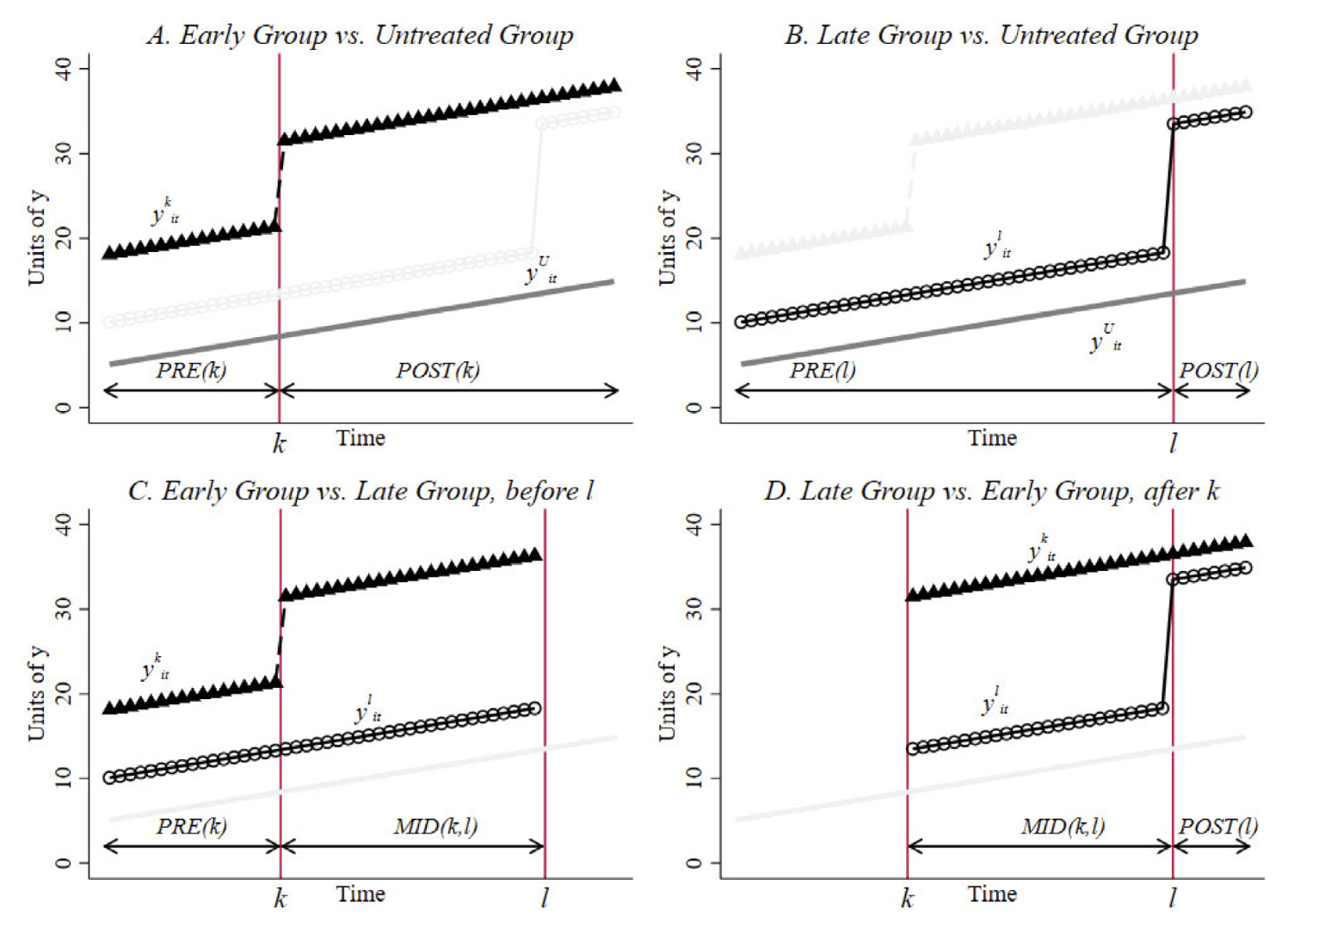
Staggered DID with TWFE
Problematic under the treatment effect heterogeneity
Goodman-Bacon (2021)

Slide 34
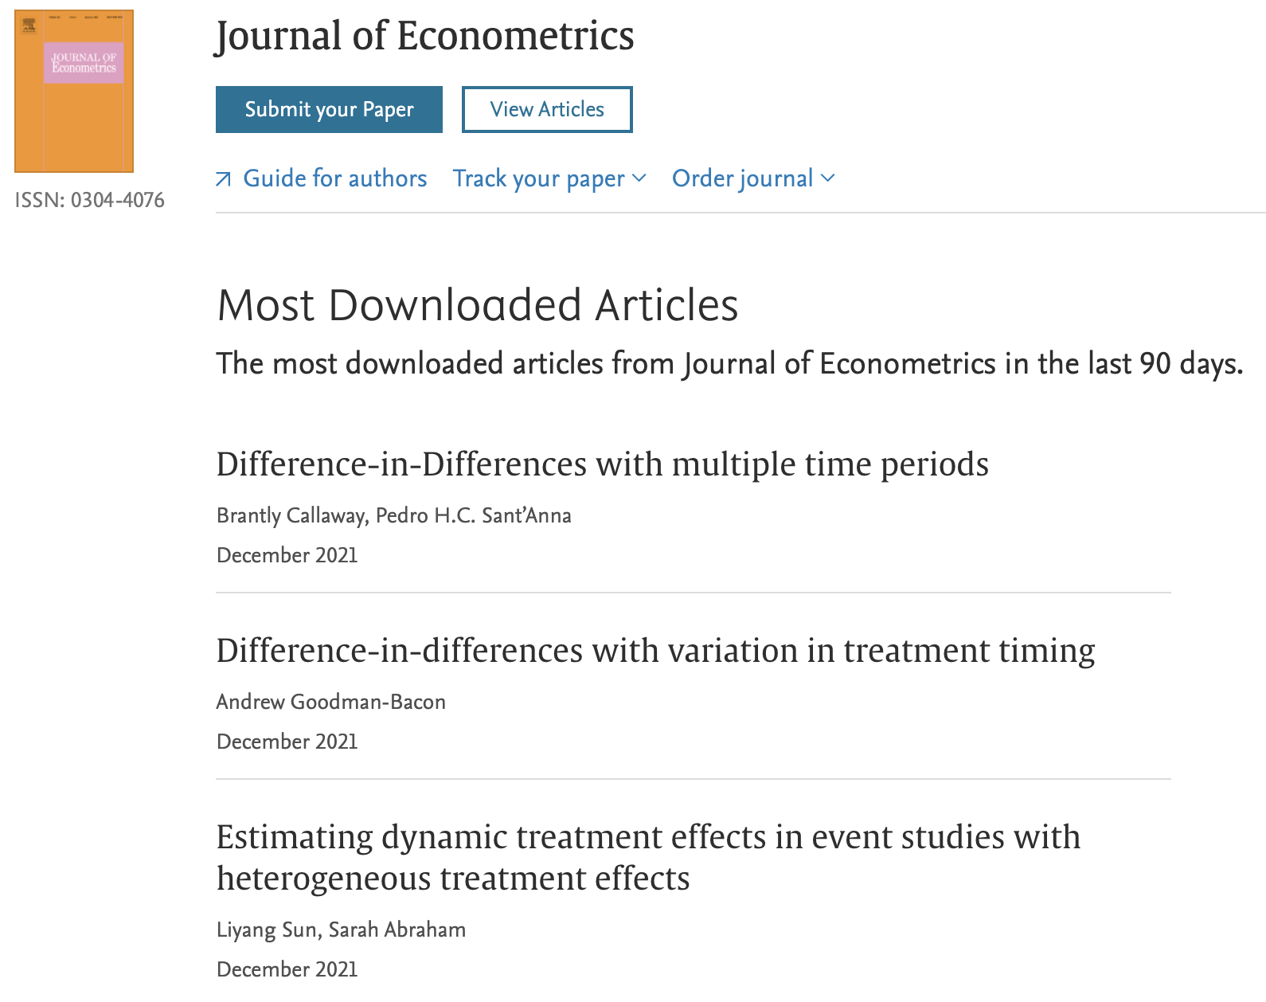
Sample and method
Alternative estimators:
Callaway and Sant’Anna (2021)
Sun and Abraham (2021)
and more

Slide 35
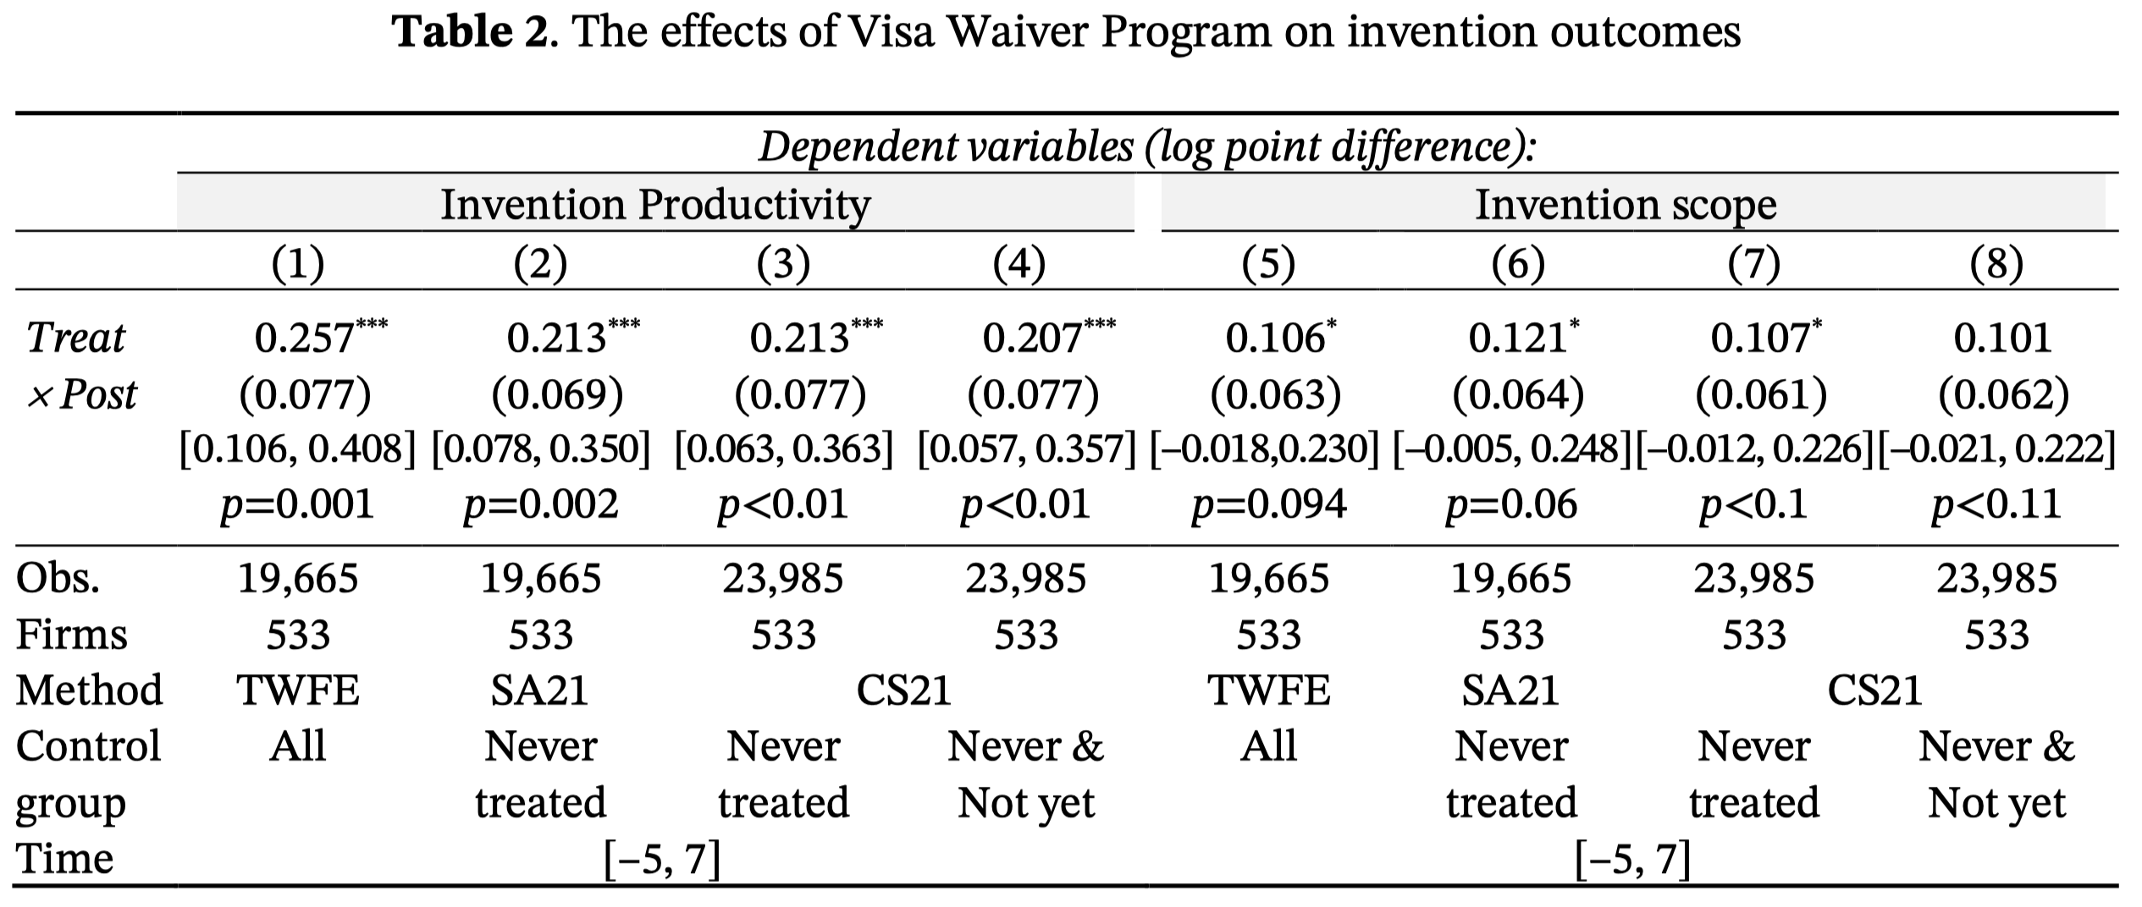
Results: Invention Productivity and Scope (H1 & H2)
Easier short-term migration increased invention productivity and scope
23% increase in patent count (≈12)
11% increase in patent scope (≈0.7)

Slide 36
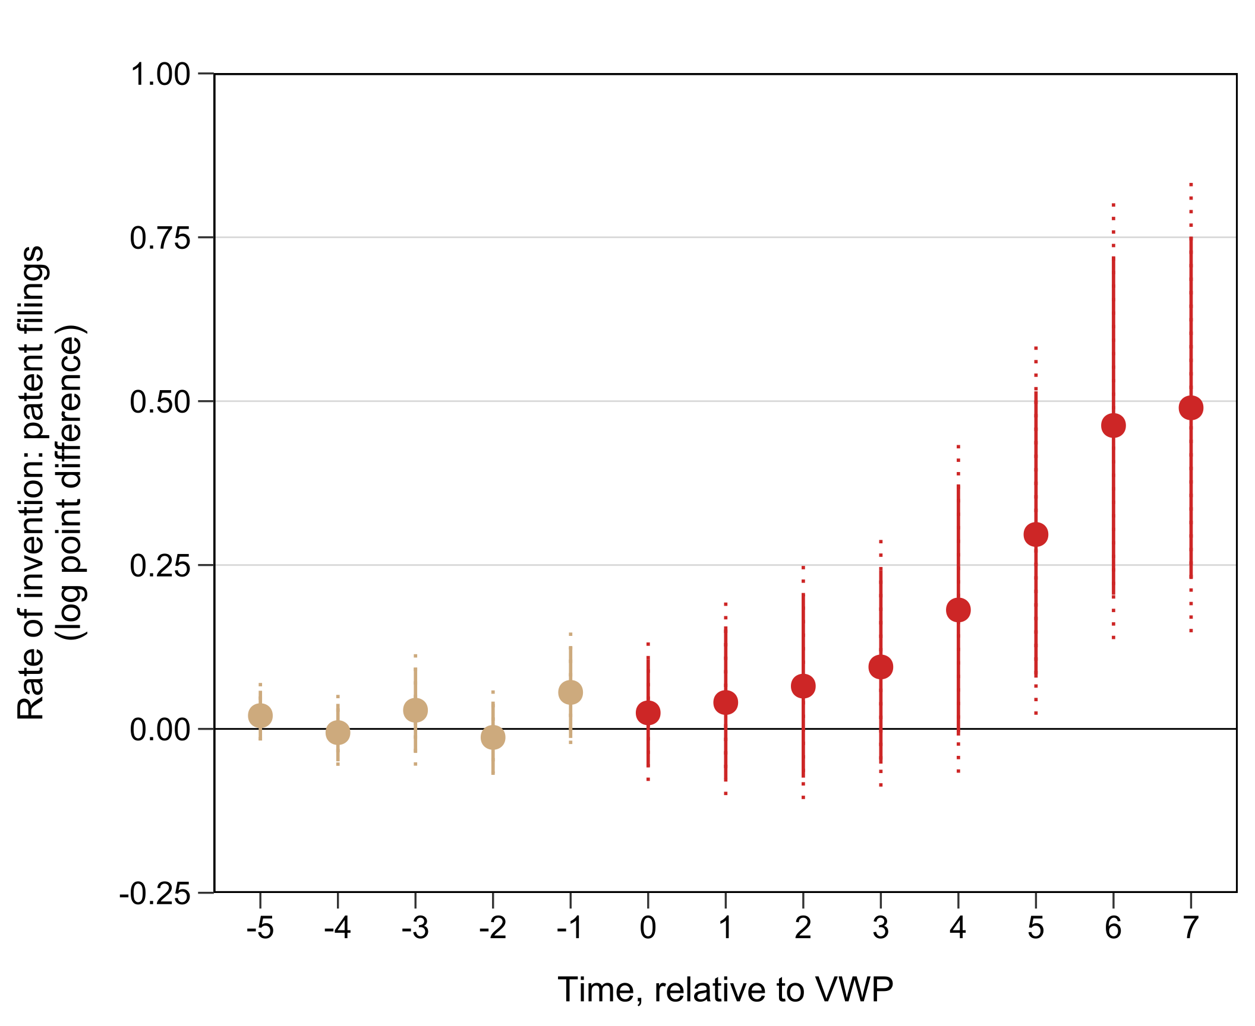
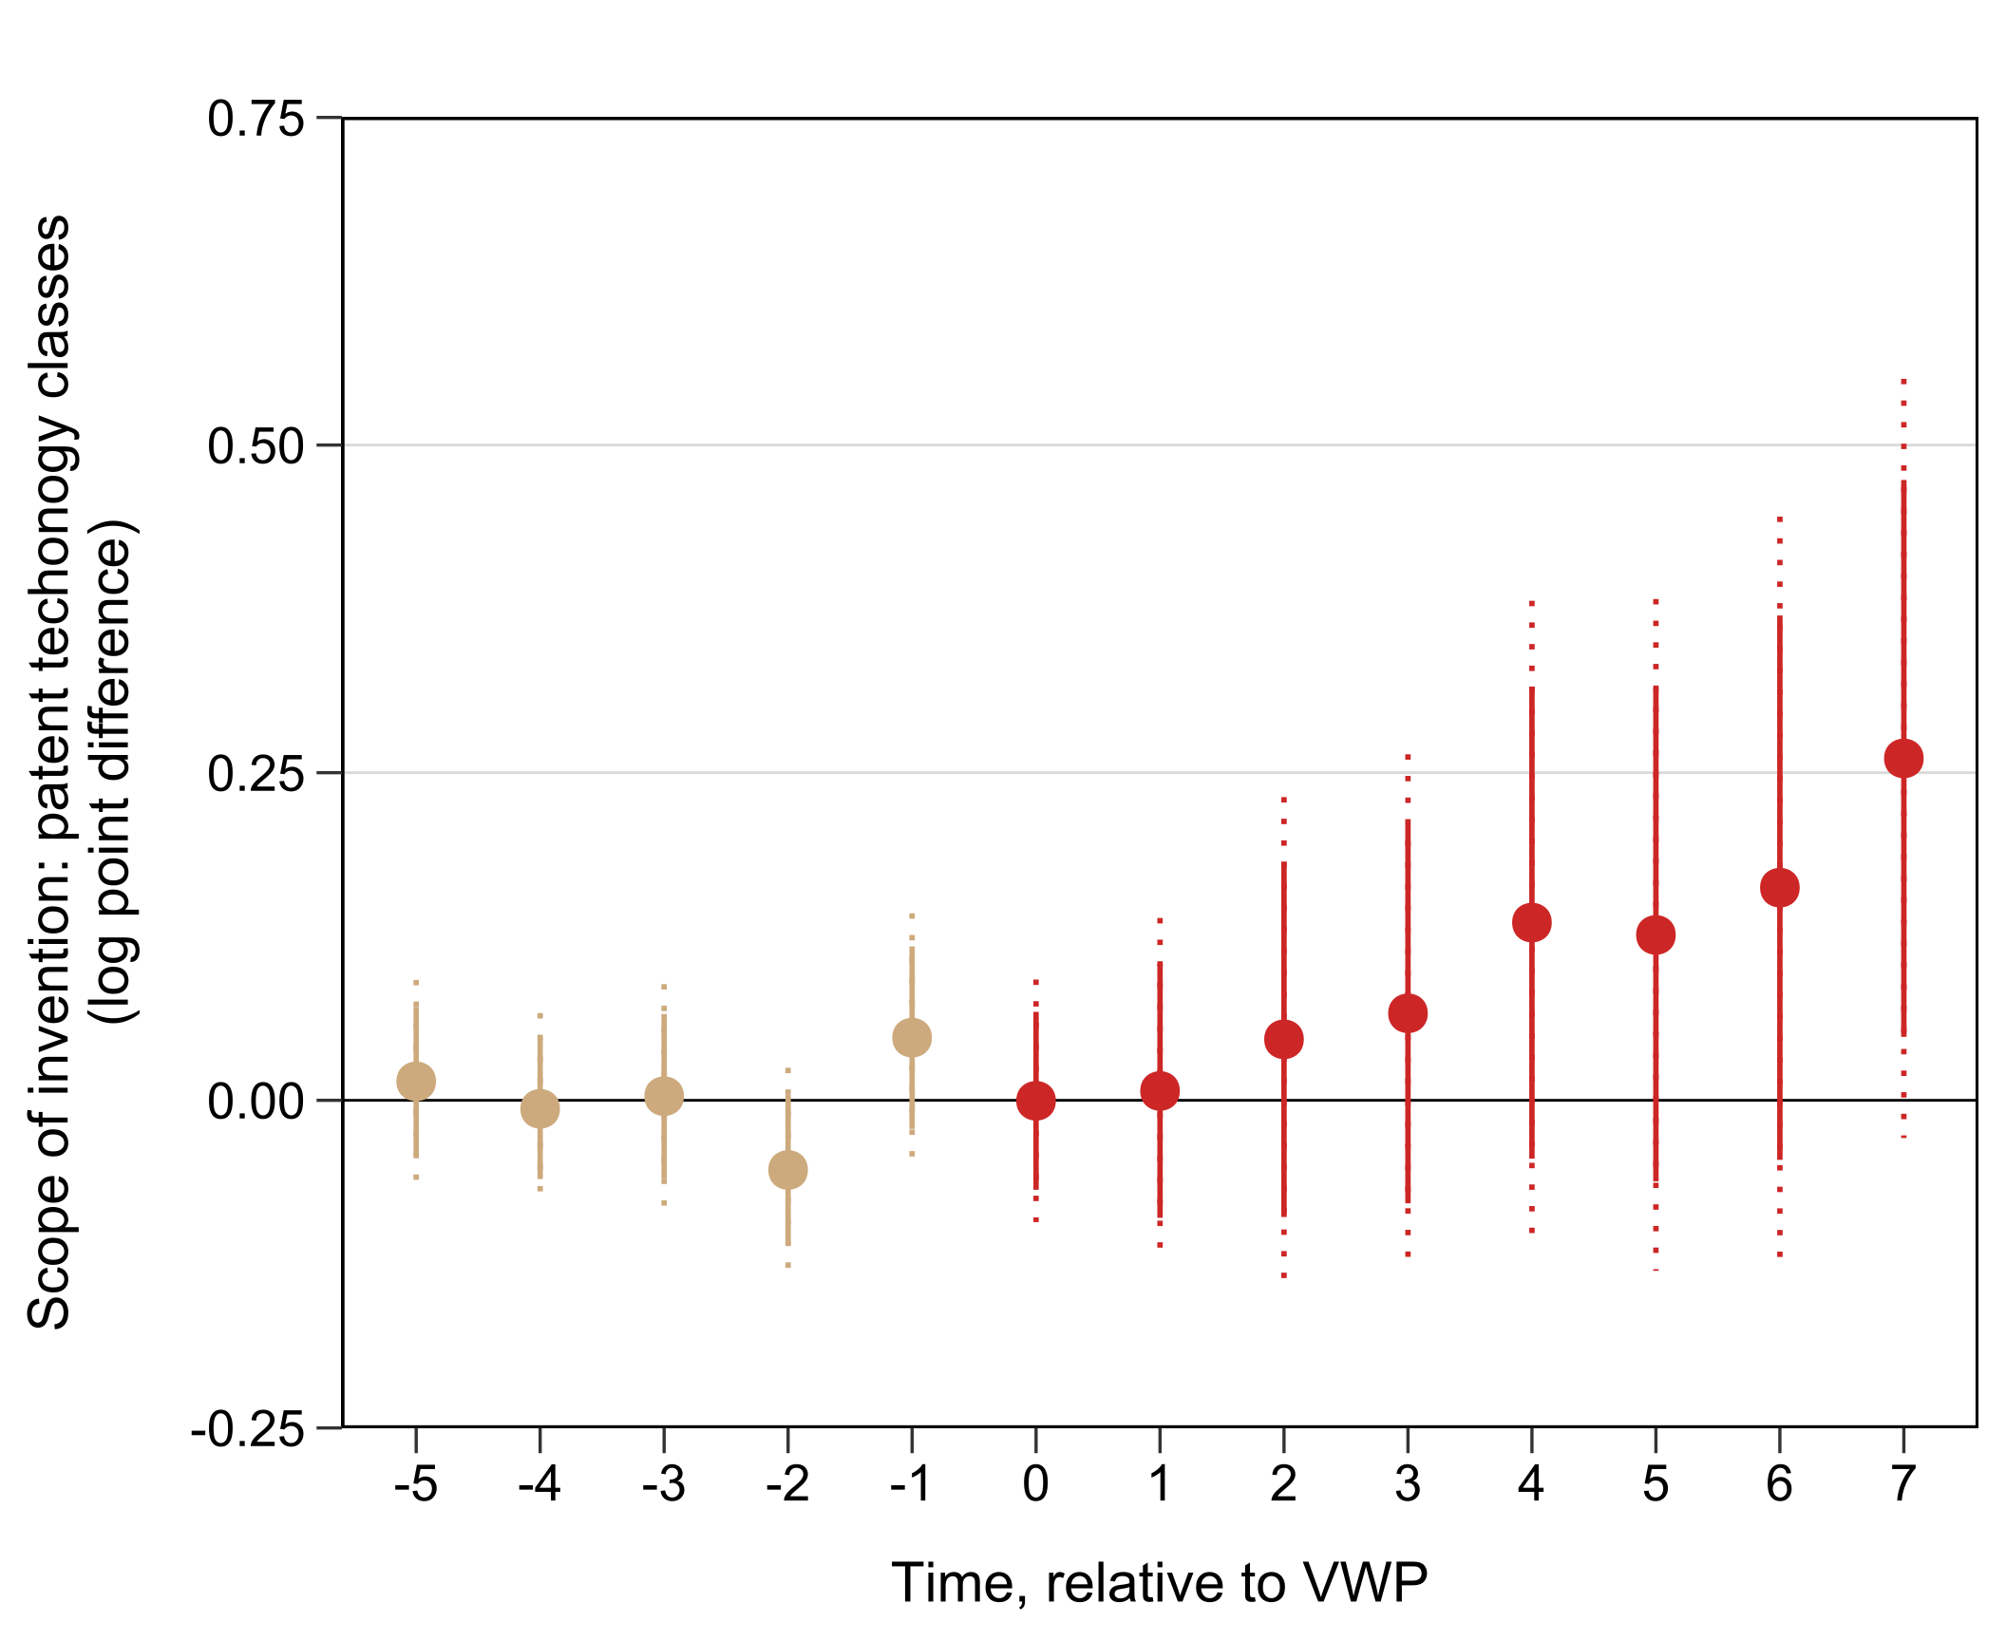
Results: Invention Productivity and Scope (H1 & H2)
Easier short-term migration increased invention productivity and scope
Invention Productivity
Invention Scope

Slide 37
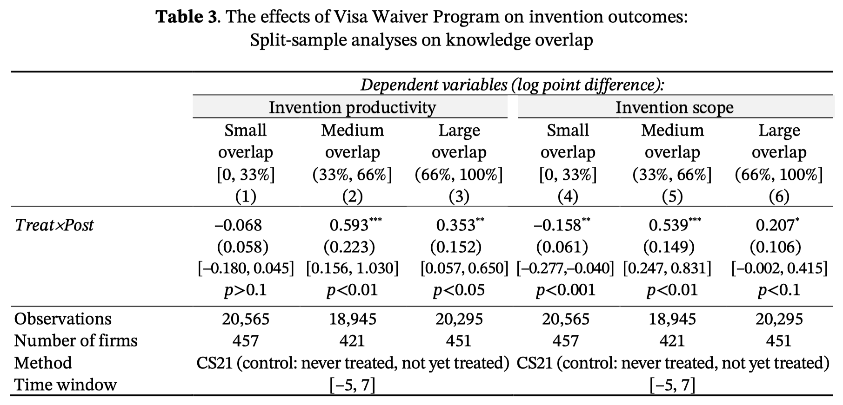
Results: Knowledge Overlap (H3)
Intermediate knowledge overlap magnified the effect

Slide 38
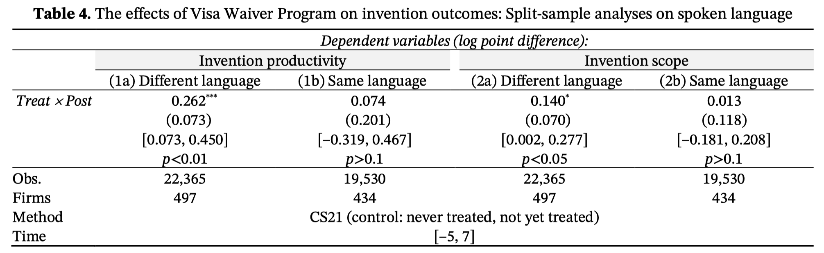
Results: Spoken Language (H4)
Firms with labs with different languages benefited more

Slide 39
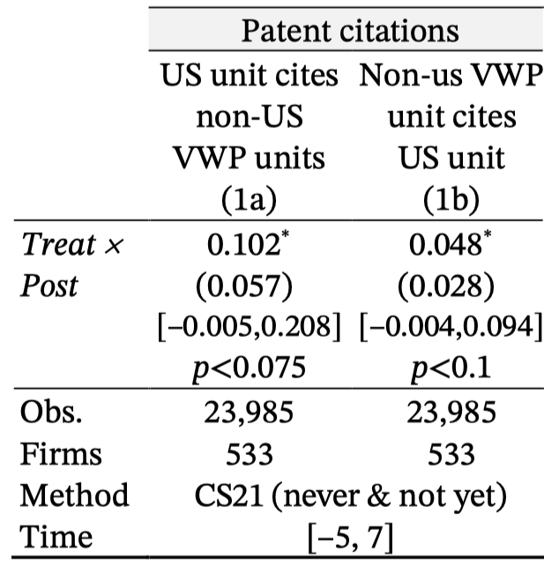
Further Analyses of Mechanisms
Coordination
In which direction did knowledge flow?

Slide 40
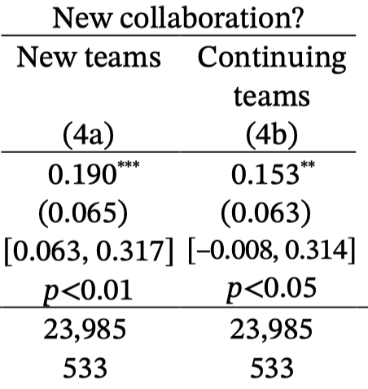
Further Analyses of Mechanisms
Coordination
In which direction did knowledge flow?
Did new teams benefit more?

Slide 41
Further Analyses of Mechanisms
Coordination
In which direction did knowledge flow?
Did new teams benefit more?
Cooperation
Did cultural distance matter?
Hofstede

Slide 42
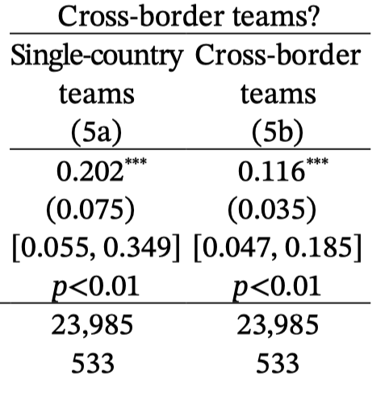
Further Analyses of Mechanisms
Coordination
In which direction did knowledge flow?
Did new teams benefit more?
Cooperation
Did cultural distance matter?
Did geographic diversity matter?

Slide 43
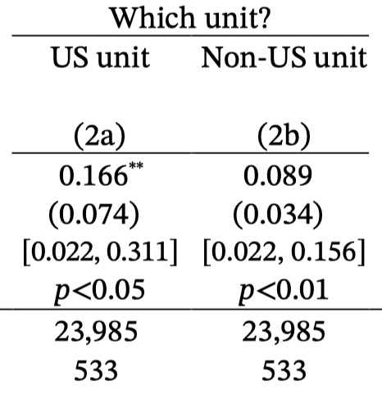
Further Analyses of Mechanisms
Asymmetry in invention benefits? (US vs non-US R&D centers)

Slide 44
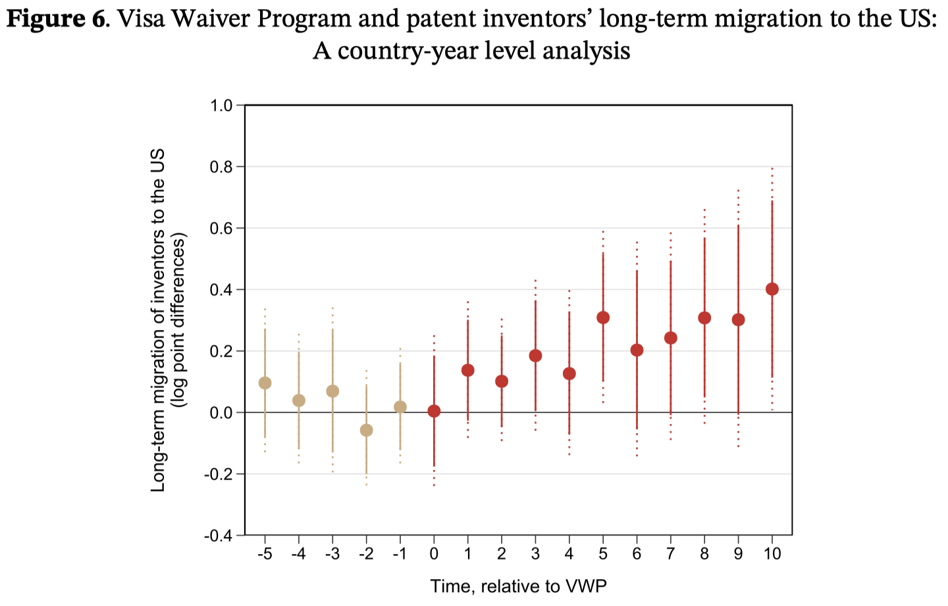
Further Analyses of Mechanisms
Asymmetry in invention benefits? (US vs non-US R&D centers
Did short-term visits facilitate long-term, permanent migration? (sample: all USPTO inventors)

Slide 45
Contributions
To the literature on organization design:
Short-term visits can help to address two key challenges: division of labor and integration of effort
Enhances coordination through enabling richer communication and effective feedback
Enhances cooperation through facilitating greater trust between employees
To the literature on innovation:
Effective recombination of knowledge requires both effective task (coordination) and relationship management (cooperation)
To the literature on international migration:
Even short-term migration can enhance business and national innovation output
With the benefits being enhanced by more diverse migration
Notes:
”residual” here means long-lasting
“diverse” here means different spoken language.

Slide 46
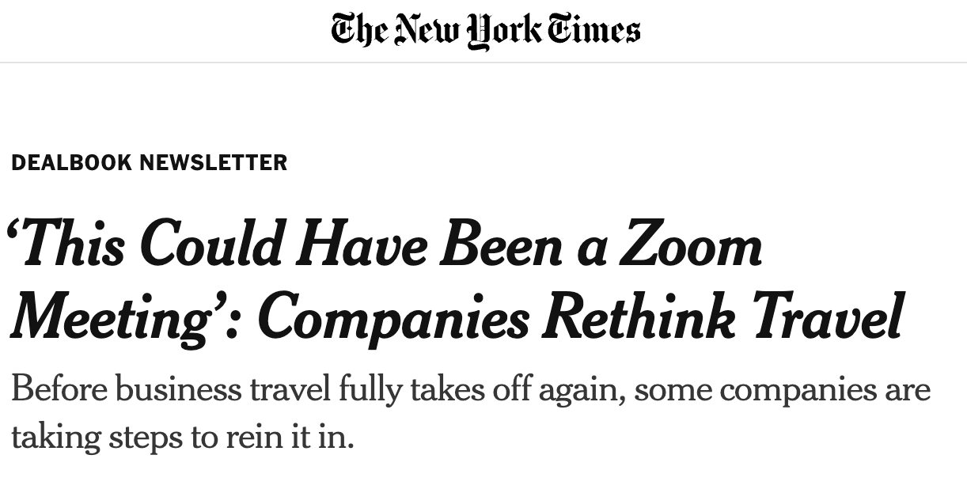
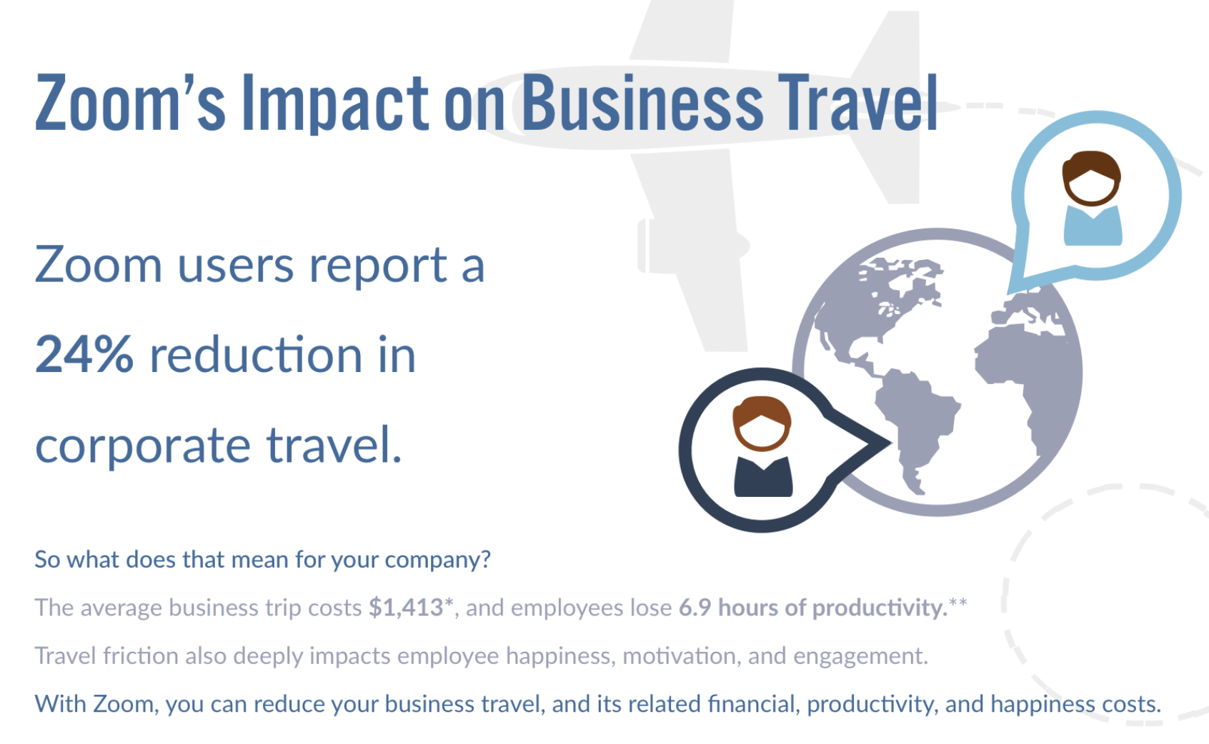
Notes:
Elimination of international business travels (why not Zoom)?
Once you have at least one face-to-face interaction
Share intermediate to high knowledge base
Or you share the same language or culture

Slide 47

Visas, Visits, and Scientific Advances (tentative title)
Hyo Kang
USC Marshall
Chunguen Yoon
KDI School
November 25, 2022
KAIST Business School
Notes:
Early stage project – actively collecting feedback and suggestions!

Slide 48
Overview
Research question
How do short-term visits affect academic collaboration and productivity?
Empirical Context
Academic publications and conference proceedings, 1981-2020
Organic collaboration via conferences and seminars
Academics don’t have R&D/publication managers; don’t face firm boundaries (leakage)
Data
Scopus data (23,452+ peer-reviewed journals, 77.8M+ records)
1981-2000: done
2001-2020: in progress

Slide 49
Visas, Visits, and Scientific Advances
Figure: Academic Collaboration (Outcome: publication count, logged)
(a). Callaway and Sant’Anna (control: net-yet & never treated)
(b). Sun and Abraham
(control: never treated)
Notes:
See time to publication by field? (the first year we see a significant effect)

Slide 50
Visas, Visits, and Scientific Advances
Fig: Effects by field
Fig: Effects by publication type
Notes:
#AGRI - Agricultural and Biological Sciences (o)
#ARTS - Arts and Humanities
#BIOC - Biochemistry, Genetics and Molecular Biology (o)
#BUSI - Business, Management and Accounting (o)
#CENG - Chemical Engineering (o)
#CHEM - Chemistry (o)
#COMP - Computer Science (o)
#DECI - Decision Sciences
#DENT - Dentistry
#EART - Earth and Planetary Sciences (o)
#ECON - Economics, Econometrics and Finance (o)
#ENER - Energy (o)
#ENGI - Engineering (o)
#ENVI - Environmental Science (o)
#HEAL - Health Professions
#IMMU - Immunology and Microbiology (not yet)
#MATE - Materials Science (not yet)
#MATH - Mathematics (o)
#MEDI - Medicine
#NEUR - Neuroscience (not yet)
#NURS - Nursing
#PHAR - Pharmacology, Toxicology and Pharmaceutics (not yet)
#PHYS - Physics and Astronomy (not yet)
#PSYC - Psychology
#SOCI - Social Sciences
#VETE - Veterinary
#MULT - Multidisciplinary

Slide 51
Visas, Visits, and Scientific Advances
Further tests planned:
Solo-authored or single-country papers
Heterogeneity by direct flight
Novel, interdisciplinary research
Early career vs. established researchers
Where to go next?

Slide 52
X
THANK YOU
Hyo Kang
hyokang@marshall.usc.edu
John Eklund
jceklund@marshall.usc.edu

